Slide 1

AstroSAGE
Analysis by Juned Shaikh
19-02-2025

Slide 2

ASTROLOGY
Welcome to AstroSage! Your abode to every form of online astrology consultation. From Vedic astrology to KP system, and everything in between, including Birth chart, Numerology, Palmistry, Tarot Reading, Aura Reading, Vastu, Spiritual Healing, Online Horoscopes, Chinese Astrology, Western Astrology, Vedic Astrology, Zodiac readings (both Sun and Moon signs) and more. Consult the best astrologers of India for instant free astrology online consultation and seek solutions to your problems.
Astrology is a method of predicting mundane events based upon the assumption that the celestial bodies—particularly the planets and the stars considered in their arbitrary combinations or configurations (called constellations)—in some way either determine or indicate changes in the sublunar world

Slide 3
How ASTROSAGE Work’s ?
How ASTROSAGE W
Information Gathering
Analysis
Horoscope (Action)
Information Gathering
Analysis
Horoscope (Action)
Once you called us we gather the information like date, time, and place of birth.
We do analysis on the data provided by the user with the large data set to provide accurate Horoscope Predictions.
We do analysis on the data provided by the user with the large data set to provide accurate Horoscope Predictions.
Once the Horoscope is Determine we guide user with the Do’s and Don’t as per the Kundli of the user

Slide 4
ASTROSAGE DATA Overview
Number of Active User : 10344, Reflecting the broad network of user we have and impact we are creating in there lives
Number of Guru’s : 131, Make sure to provide accurate information and handle client swiftly.
Geographical Coverage : Service Reaches 28 States and 365 Cities in India, Shows Nation Wide Penetration.

Slide 5
ASTROSAGE DATA Cleaning
Removing Duplicate in order for accurate analysis of Raw Data to get Accurate Results.
Missing Value are replaced with the Average or with the valid format in the required column to maintain the data consistency and accuracy.
This Data-Set allows in-dept understanding of ASTROSAGE market presence and operational scope.
High Quality Data is crucial for analyzing sales trends, customer behavior , and agents performance.
Insights from user demographics and order volumes are key to optimizing marketing strategies and expanding product offerings.

Slide 6
ANALYTICAL APPROCH and TOOLS USED:
Data Cleaning: Utilized Functions Like TRIM, CLEAN and Remove Duplicates to ensure data accuracy.
Data Enrichment: Enhanced the dataset with additional variables using VLOOKUP to across reference external data source.
Descriptive Analysis: Employed PivotTables for summarizing key metrics and identifying sales patterns across different regions and product categories.
Customer Segmentation: Applied SORT and FILTER functions to classify customers based on purchasing behavior and demographics.
Visualizations: Created dynamic charts and dashboards for data representation, enabling interactive data exploration.

Slide 7
Problem Statement:
What metrics should be included in the final dashboard to provide a comprehensive view of call center performance and guide investment decisions.
How would you allocate a 1 crore rupee investment to optimize operational efficiency, enhance customer satisfaction, and boost profitability, and what analysis-based recommendations would you offer to support this.

Slide 8
Revenue Generated
Row Labels | Sum of Profit
Call | 90721.18
Chat | 24156.04
Complementary | 0.00
public_live_Call | 42.11
Grand Total | 114919.33
Insights:-
The Revenue Generated from Calls is higher as compared to Chat and other sources.

Slide 9
DAY by DAY Volume:
Insights:-
Day by Day Volume show the frequency of the volume managed by guru. So we can effectively manage holidays and planed leaves for our agents.

Slide 10
Peek Volume as per hours:
Insights:-
This will help us arrange more agent in shift where the volume is more this will help us reduce the hold time for the user and increase customer satisfaction.

Slide 11
Website Distribution:
Insights:-
This Pie Chart Help Us understand the Distribution of the User across platform.
The Gurucool has the Highest User Retention among all

Slide 12
Call /Chat Status of Completion:
Insights:-
This Pie Chart Help Us understand the Distribution of the User across platform.
The Gurucool has the Highest User Retention among all

Slide 13
Top Performing Gurus:
Insights:-
The Bar Graphs give the insights of the top performing gurus that will help us to set the expectation on the performance of the rest of the team.
This will help to provide proper training to the non-performing employee by the top performers’s

Slide 14
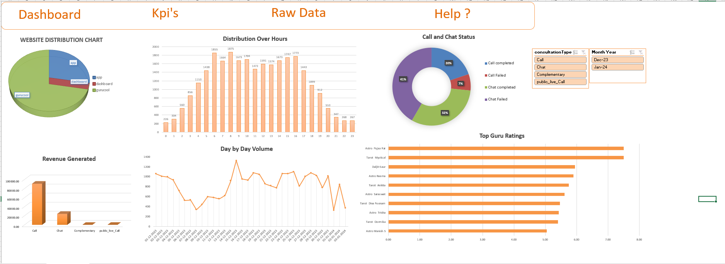
Dashboard:

Slide 15
CONCLUSION:
Recommendation:- (Solutions)
To Solve the Call/Chat Failure and Incompletion we should invest in a good CRM and Calling System with IVR. So Agent can make a track of failed calls/chats and can manage it more efficiently and this will also make a slight improvement in the customer satisfaction rate.
Invest in a good Calling system / Work Force Management system will improve the Agent Cases per day count so this will also track the Performance of the Agent thus management can track the agent performance and KPI’s
A CRM System can also be used to provide knowledge base articles to the user to handle the client more effectively and improve repetitive call ration so the sales will also improve drastically.
Investment in a Training System so agents will be on track with the market and organizational trends. To handle client in more professional manner to increase sales and improve overall rating for the organization.

